Slide 1
Information System Security CMIS 422 Details of Cryptography Module 3 Mona Taghavi

Slide 2
Session Overview
Basic terms and primitives of cryptography
Symmetric encryption algorithms
RSA asymmetric encryption algorithm
Message digest algorithms

Slide 3
Cryptographic Primitives
Substitution
One set of bits is exchanged for another (eg. Ceaser algorithm)
Transposition (Permutation)
Rearranging the order of the ciphertext to break any repeating patterns in the underlying plaintext

Slide 4
Confusion
An algorithm providing good confusion has a complex functional relationship between the plaintext/key pair and the ciphertext, so that changing one character in the plaintext causes unpredictable changes to the resulting ciphertext

Slide 5
Diffusion
Distributes the information from single plaintext characters over the entire ciphertext output, so that even small changes to the plaintext result in broad changes to the ciphertext

Slide 6
Shannon’s Characteristics of Good Ciphers
The amount of secrecy needed should determine the amount of labor appropriate for the encryption and decryption
The set of keys and the enciphering algorithm should be free from complexity
The implementation of the process should be as simple as possible
Errors in ciphering should not propagate and cause corruption of further information in the message
The size of the enciphered text should be no larger than the text of the original message

Slide 7
Properties of a Trustworthy Cryptosystem
It is based on sound mathematics
It has been analyzed by competent experts and found to be sound
It has stood the test of time

Slide 8
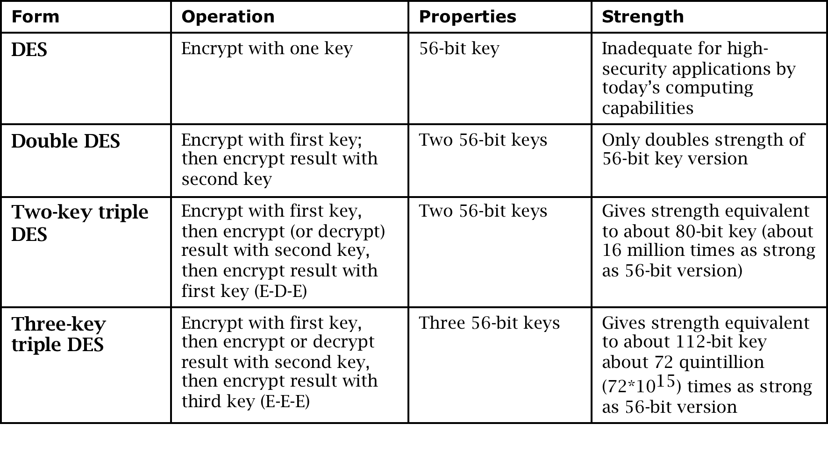
DES: The Data Encryption Standard
Symmetric block cipher
Developed in 1976 by IBM for the US National Institute of Standards and Technology (NIST)

Slide 9
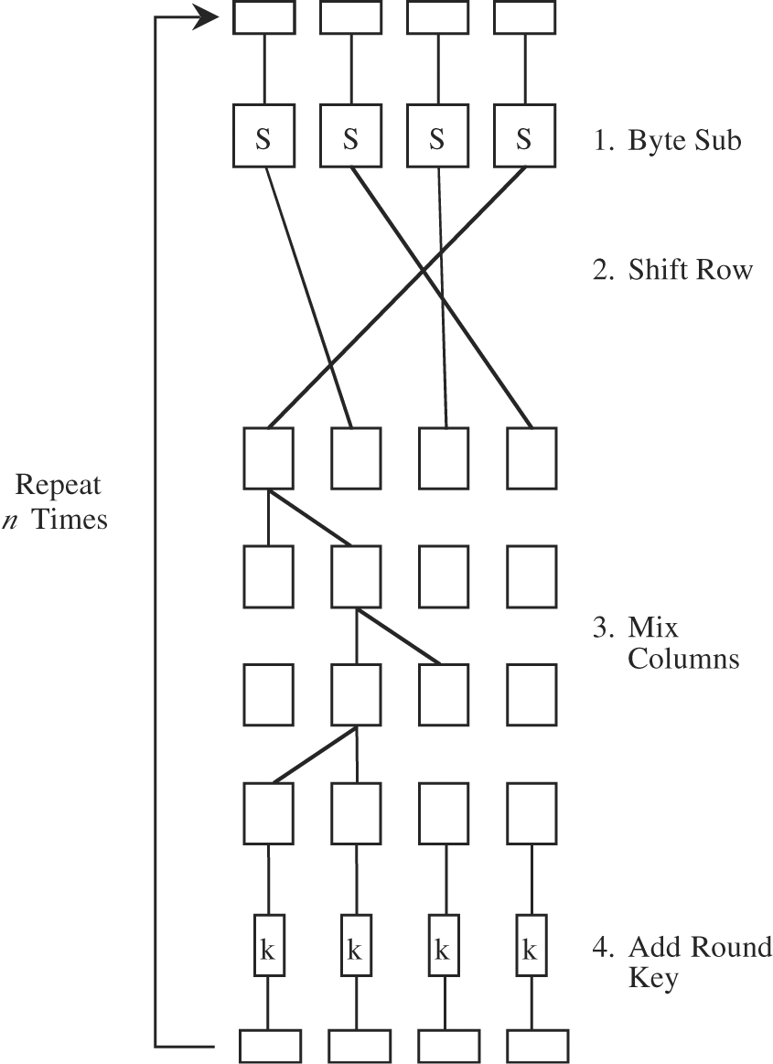
AES: Advanced Encryption System
Symmetric block cipher
Developed in 1999 by independent Dutch cryptographers
Still in common use

Slide 10
DES vs. AES

Slide 11
DES Algorithm (cont.)

Slide 12
DES Algorithm (cont.)

Slide 13
DES Algorithm (cont.)

Slide 14
Chaining
DES uses the same process for each 64-bit block, so two identical blocks encrypted with the same key will have identical output
This provides too much information to an attacker, as messages that have common beginnings or endings, for example, are very common in real life, as is reuse of a single key over a series of transactions
The solution to this problem is chaining, which makes the encryption of each block dependent on the content of the previous block as well as its own content

Slide 15
Simple Chaining Example
The input of the second block is an XOR of the output of the first block and the plaintext of the second block.
This has the effect of making identical plaintext in two different messages produce completely different ciphertext.

Slide 16
Simple Chaining Example
But what about the first block?

Slide 17
Initialization Vectors

Slide 18
Structure of AES
AES is much more complex than DES, and we will not explain it in detail here.
The algorithm consists of 10, 12, or 14 cycles, for a 128-, 192-, or 256-bit key, respectively.

Slide 19
Structure of AES
Each cycle consists of four steps:
Byte substitution:
This step substitutes each byte of a 128-bit block according to a substitution table.
This is a straight diffusion operation.
Shift row:
Certain bits are shifted to other positions.
This is a straight confusion operation.
Mix column.
This step involves shifting left and XORing bits with themselves.
These operations deliver both confusion and diffusion.
Add subkey:
Here, a portion of the key unique to this cycle is XORed with the cycle result. This operation delivers confusion and incorporates the key.
Each cycle performs both confusion and diffusion as well as blends the key into the result.

Slide 20
Structure of AES

Slide 21
Longevity of AES
Since its initial publication in 1997, AES has been extensively analyzed, and the only serious challenges to its security have been highly specialized and theoretical
Because there is an evident underlying structure to AES, it will be possible to use the same general approach on a slightly different underlying problem to accommodate keys larger than 256 bits when necessary
No attack to date has raised serious question as to the overall strength of AES

Slide 22
The Rivest-Shamir-Adleman (RSA) Algorithm For Public-key Cryptography — The Basic Idea
It is named after its inventors Ron Rivest, Adi Shamir and Len Adleman.
Published in 1978
It is the most widely used public‐key encryption algorithm today.
It provides confidentiality and digital signatures.
Its security is based on the difficulty of integer factorization

Slide 23
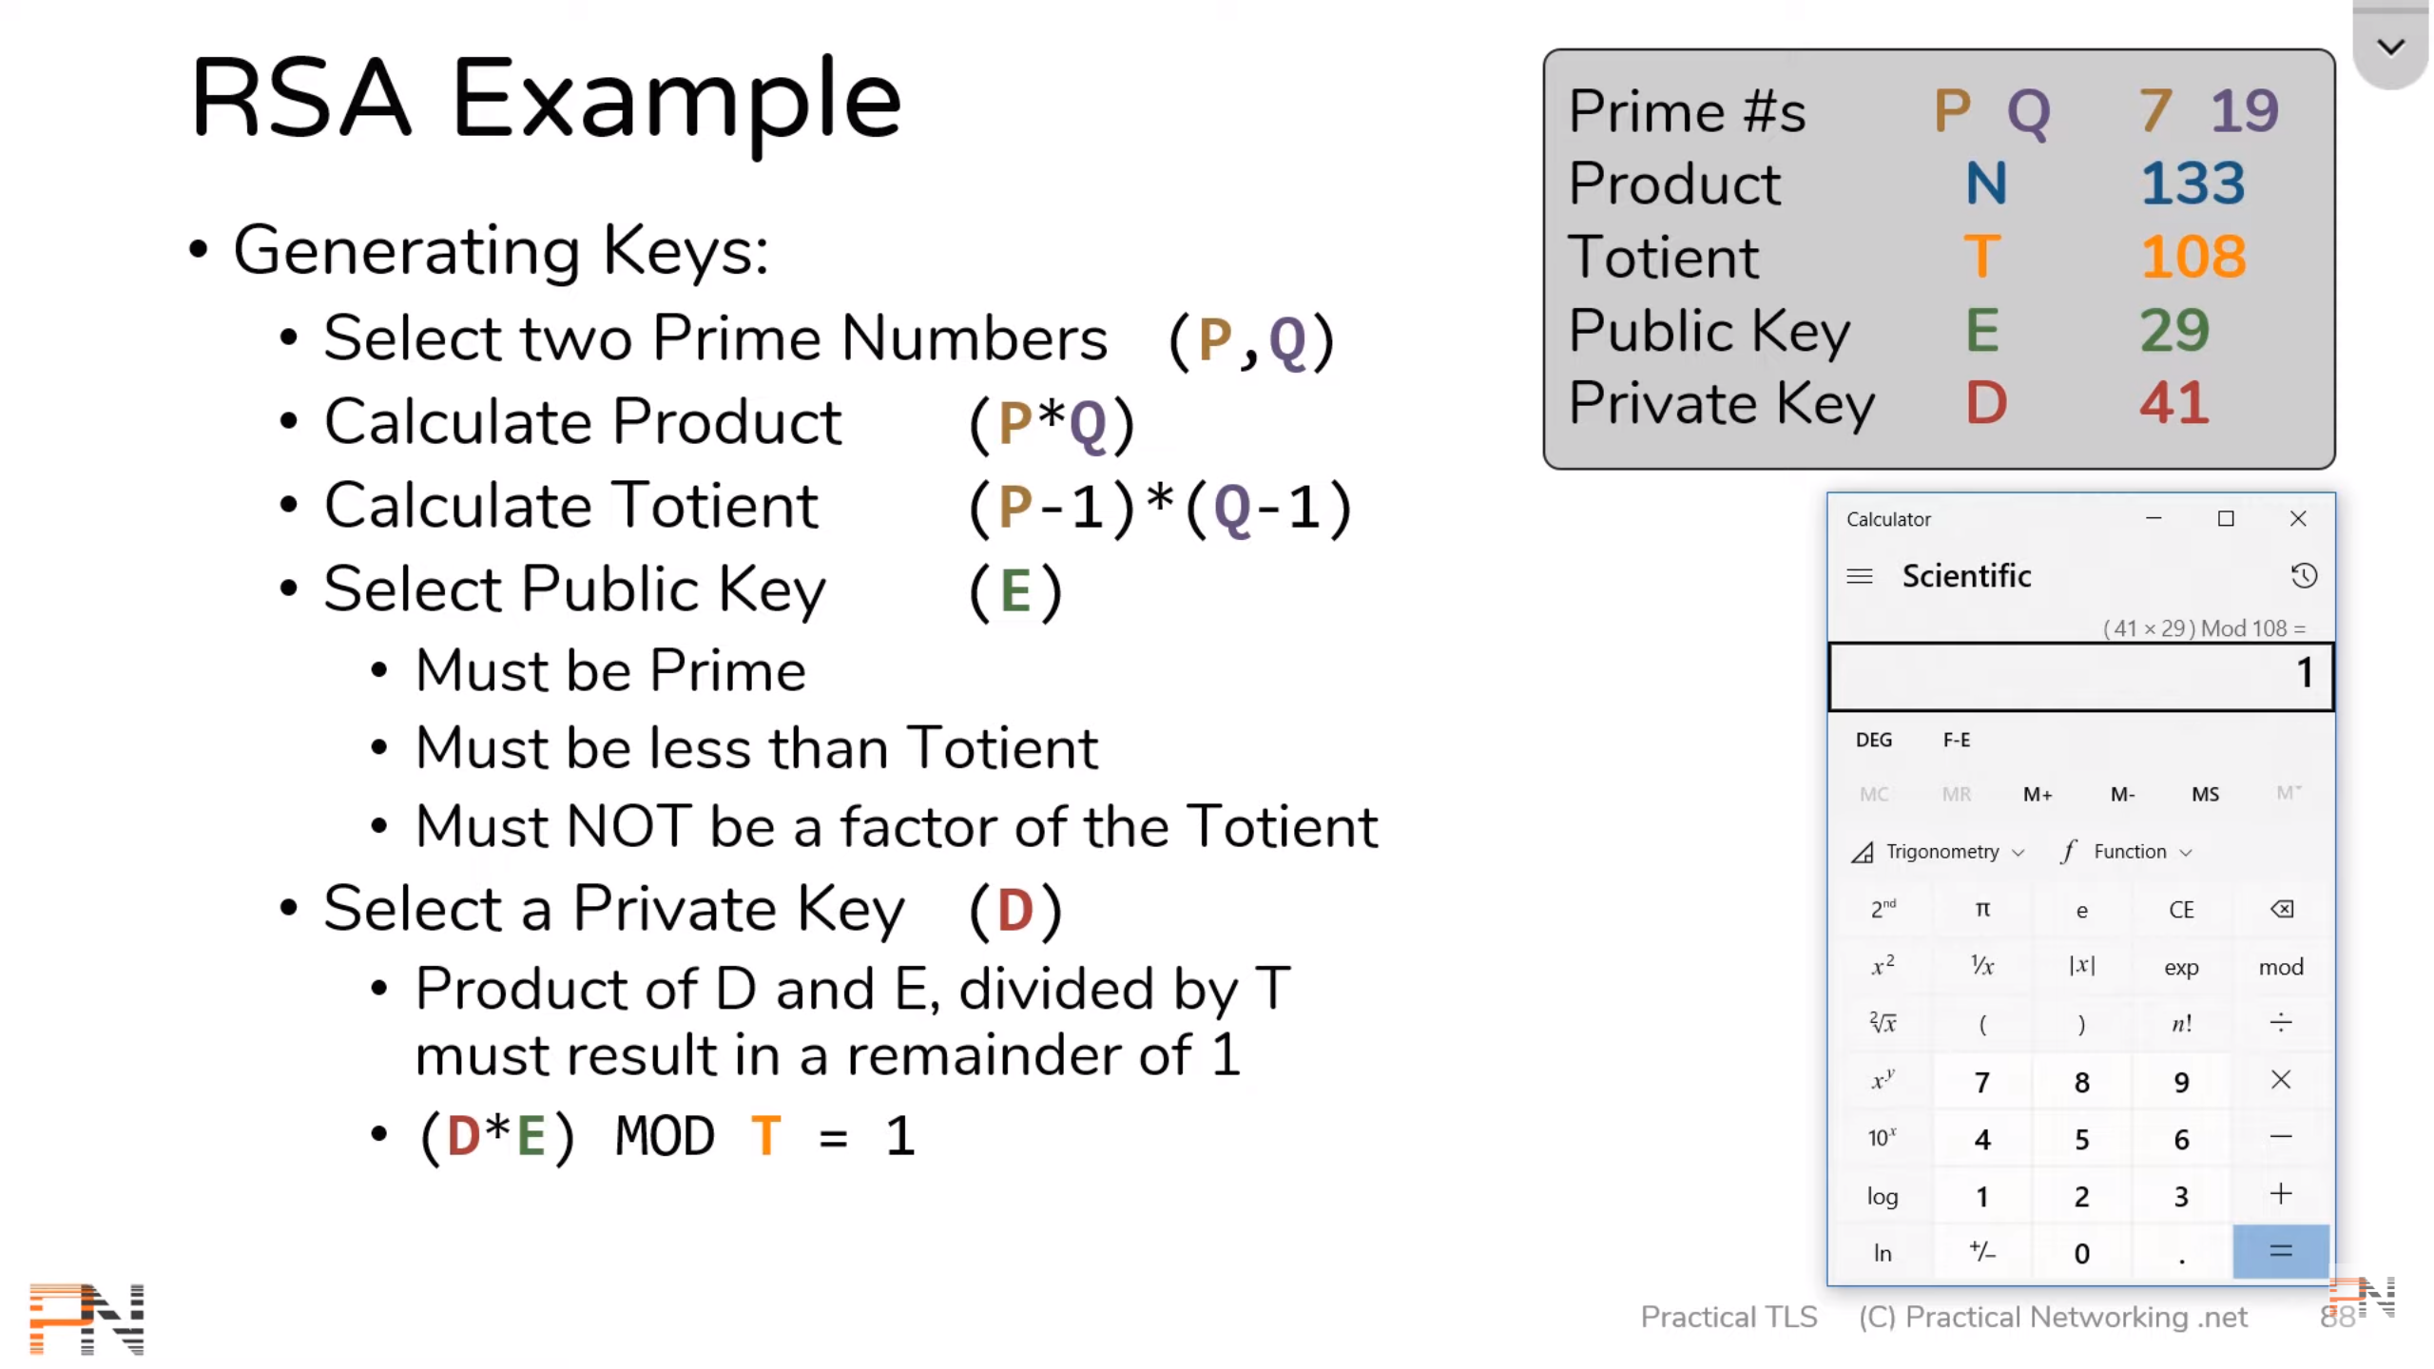
RSA Steps

Slide 24
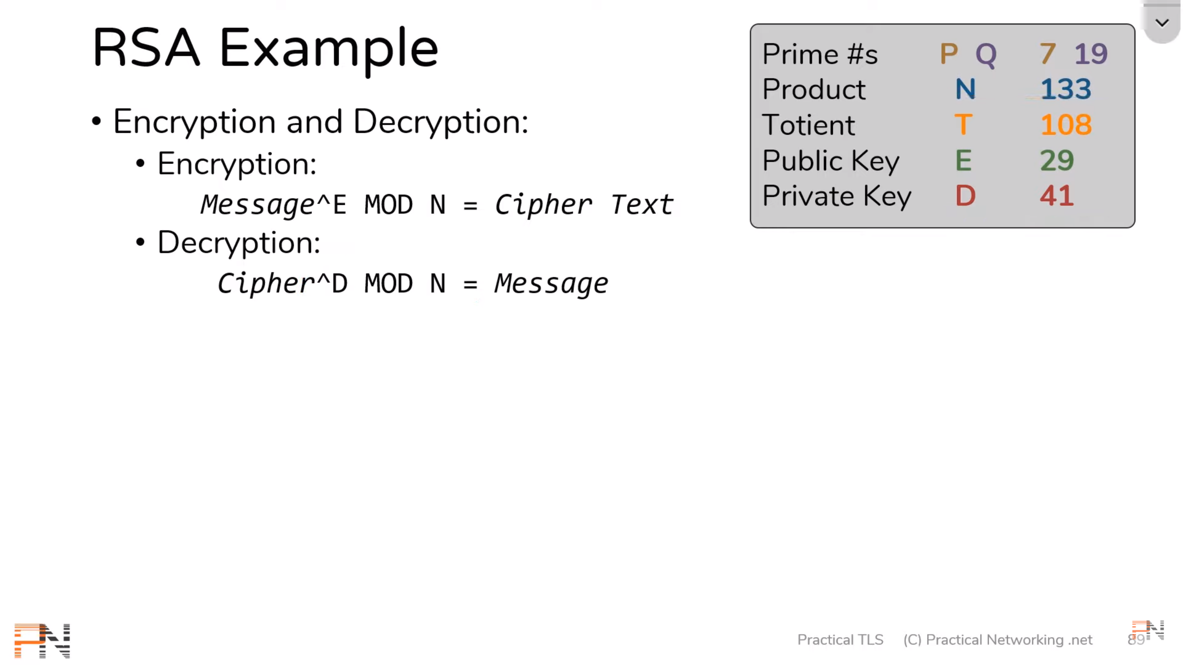
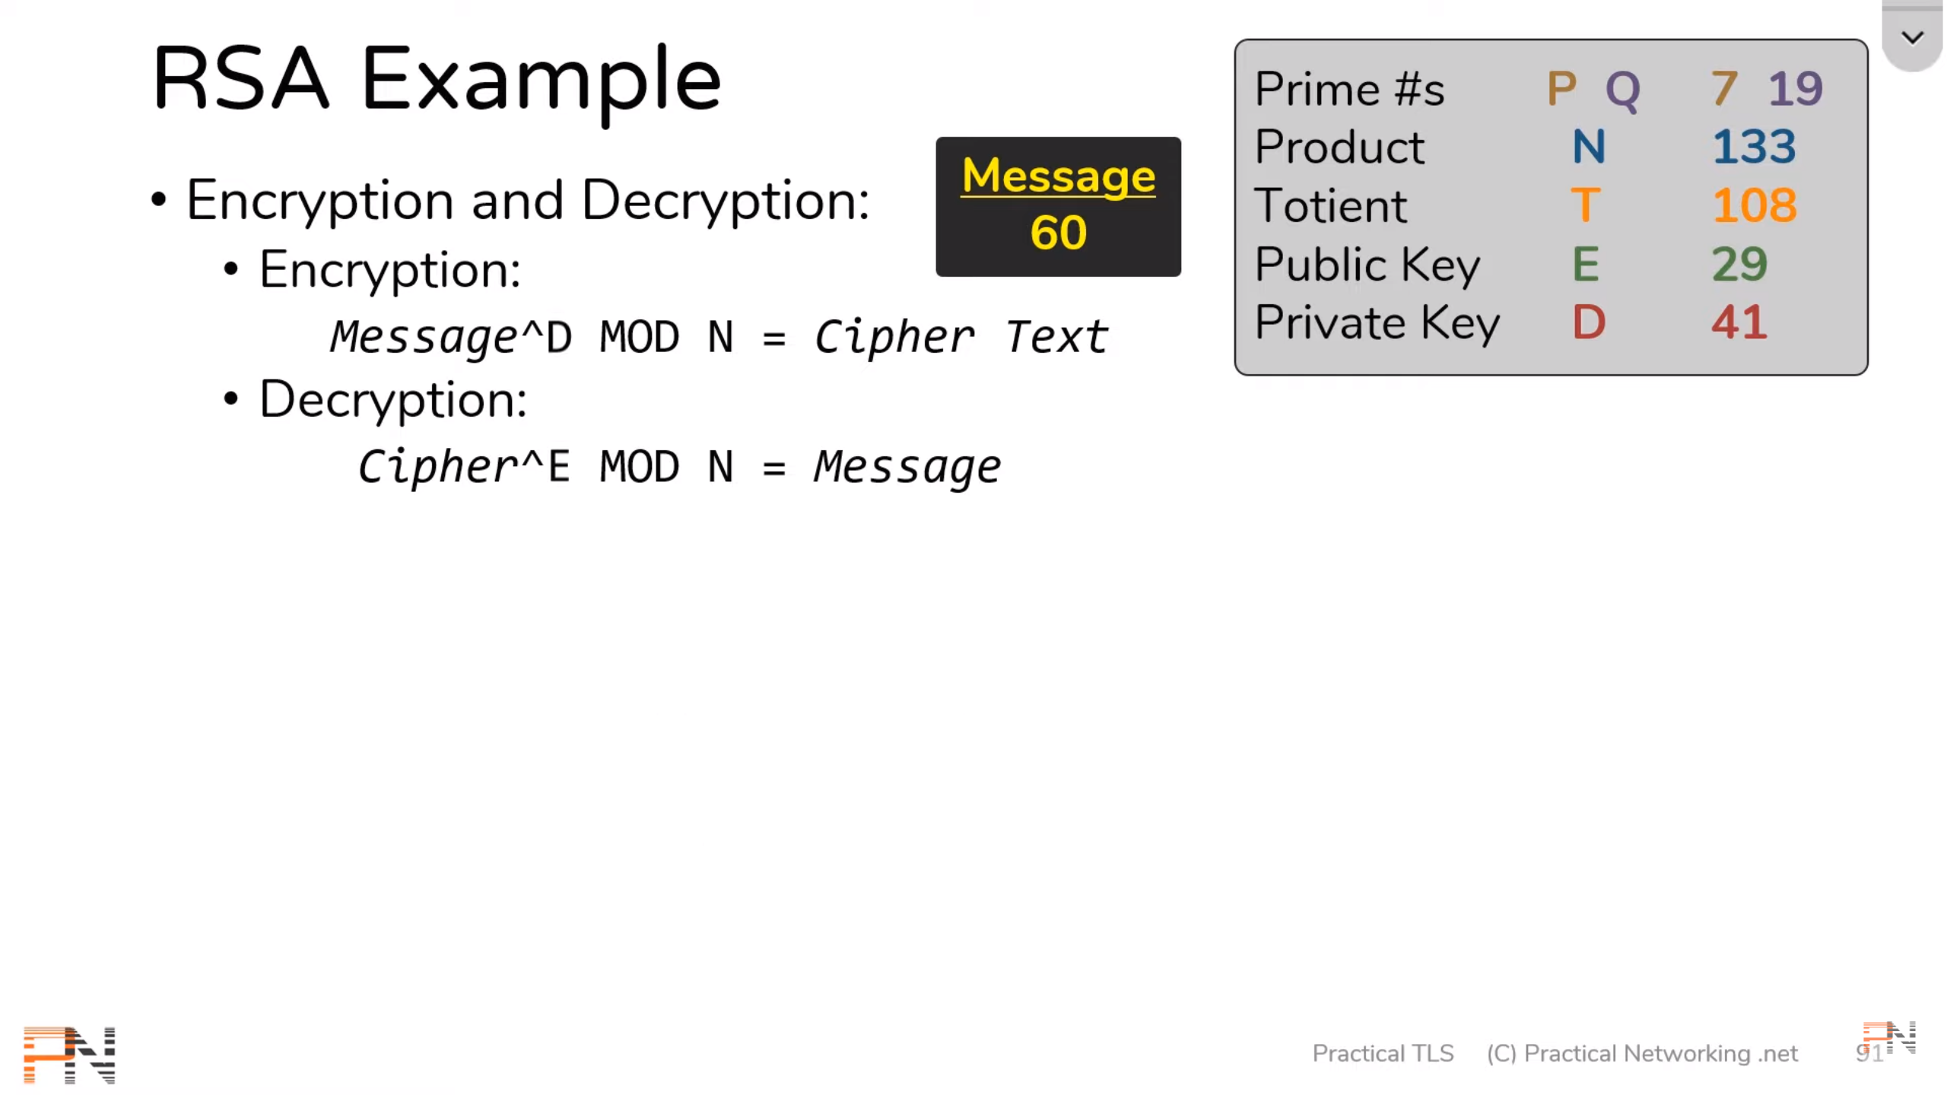
RSA Encryption and Decryption

Slide 25
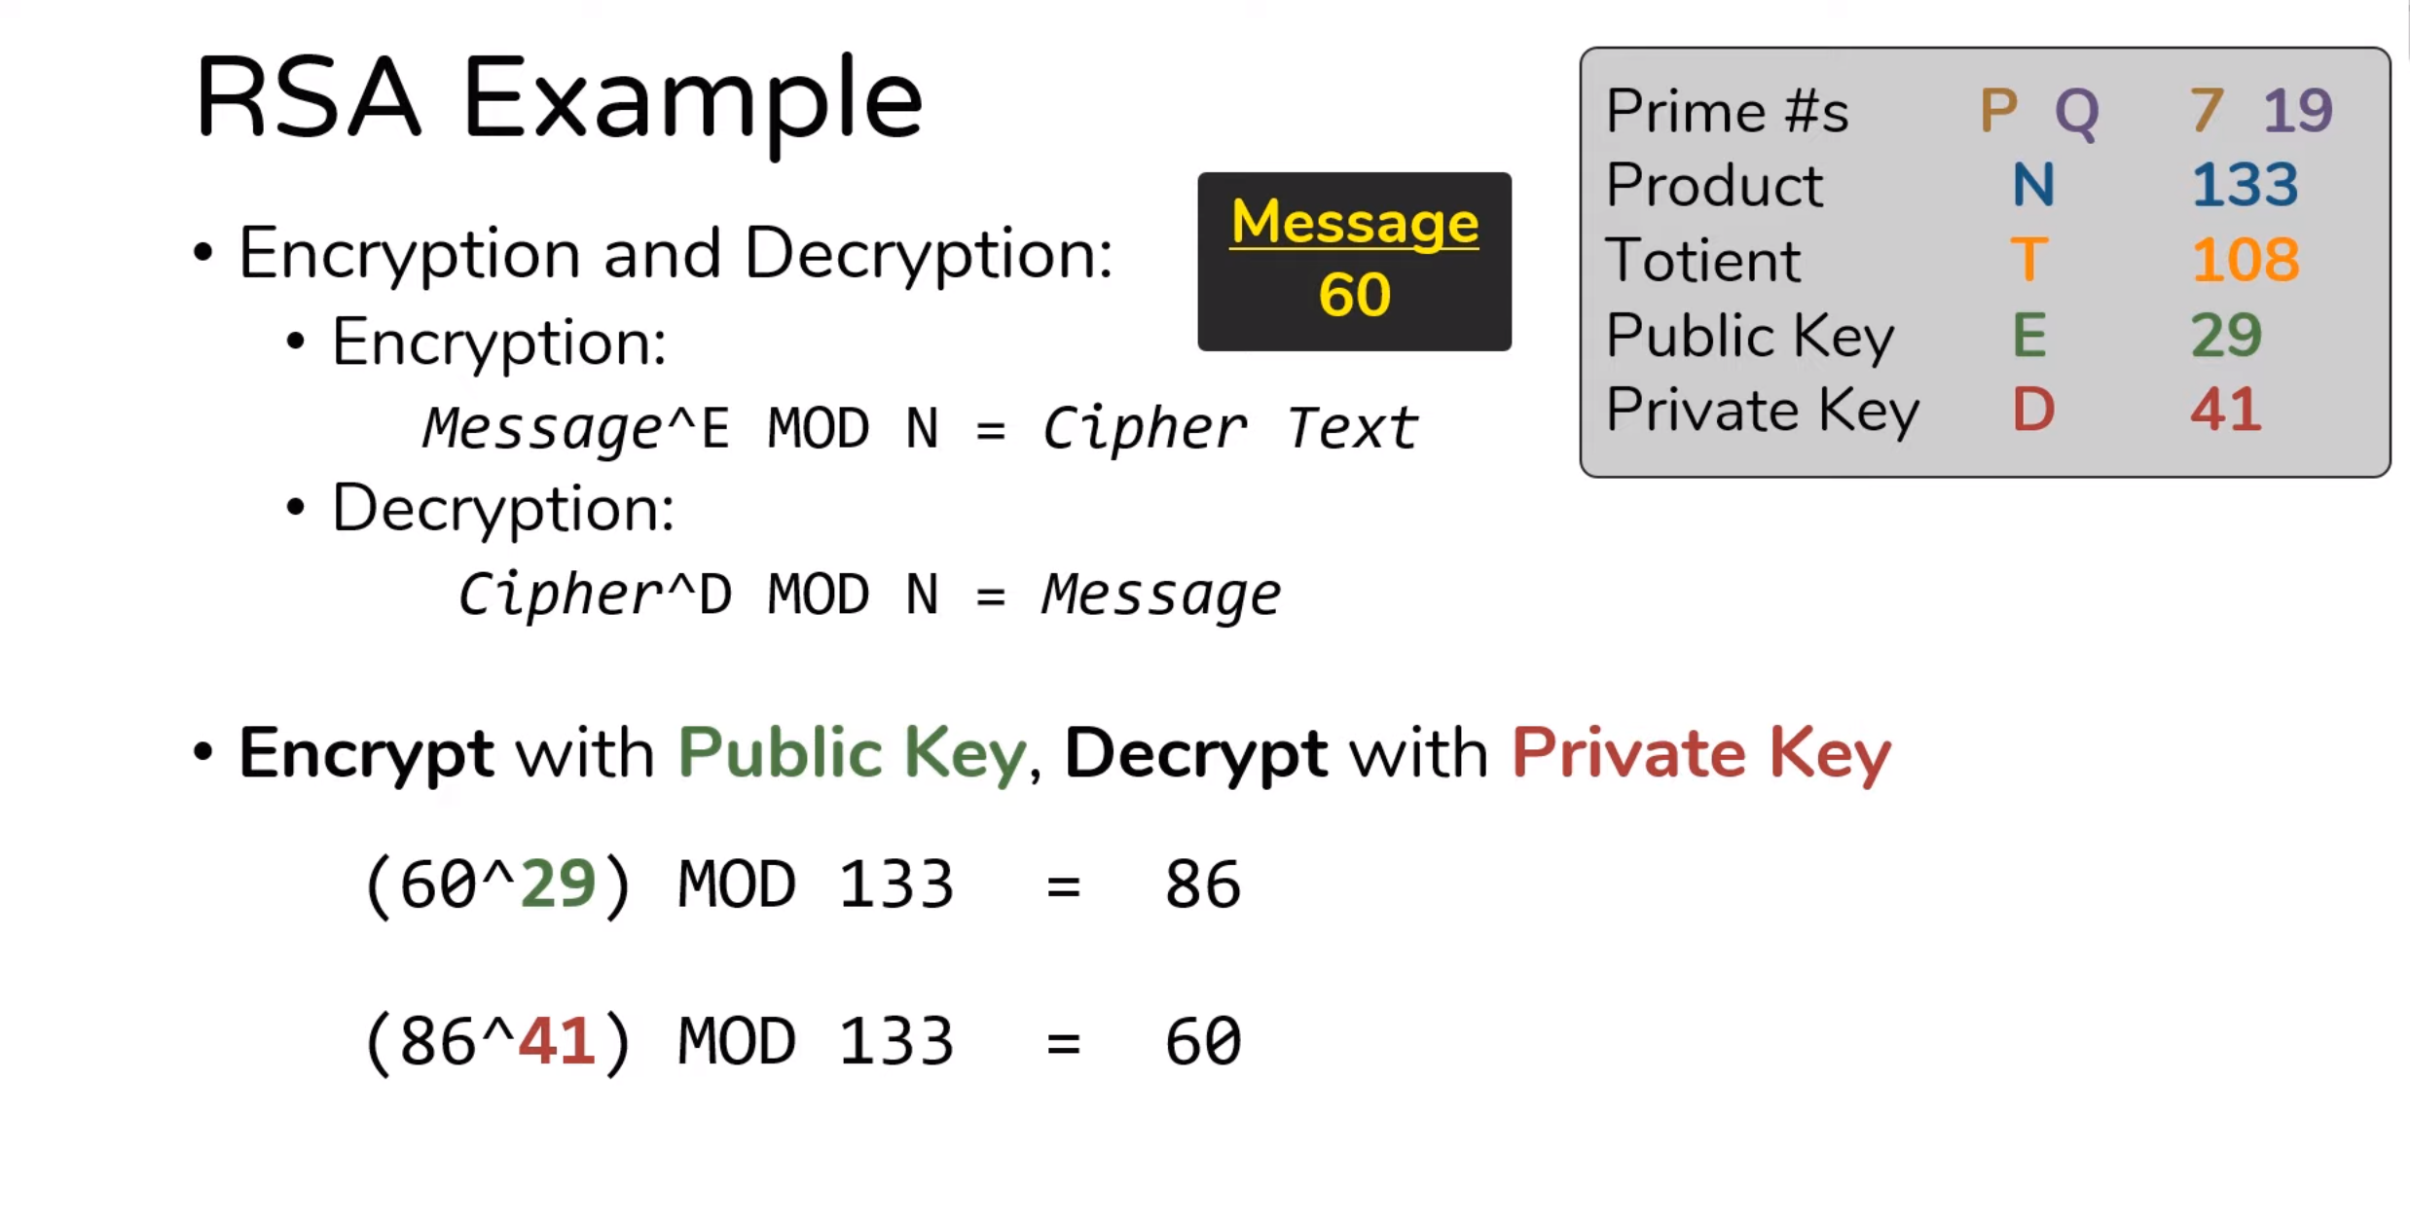

Slide 26
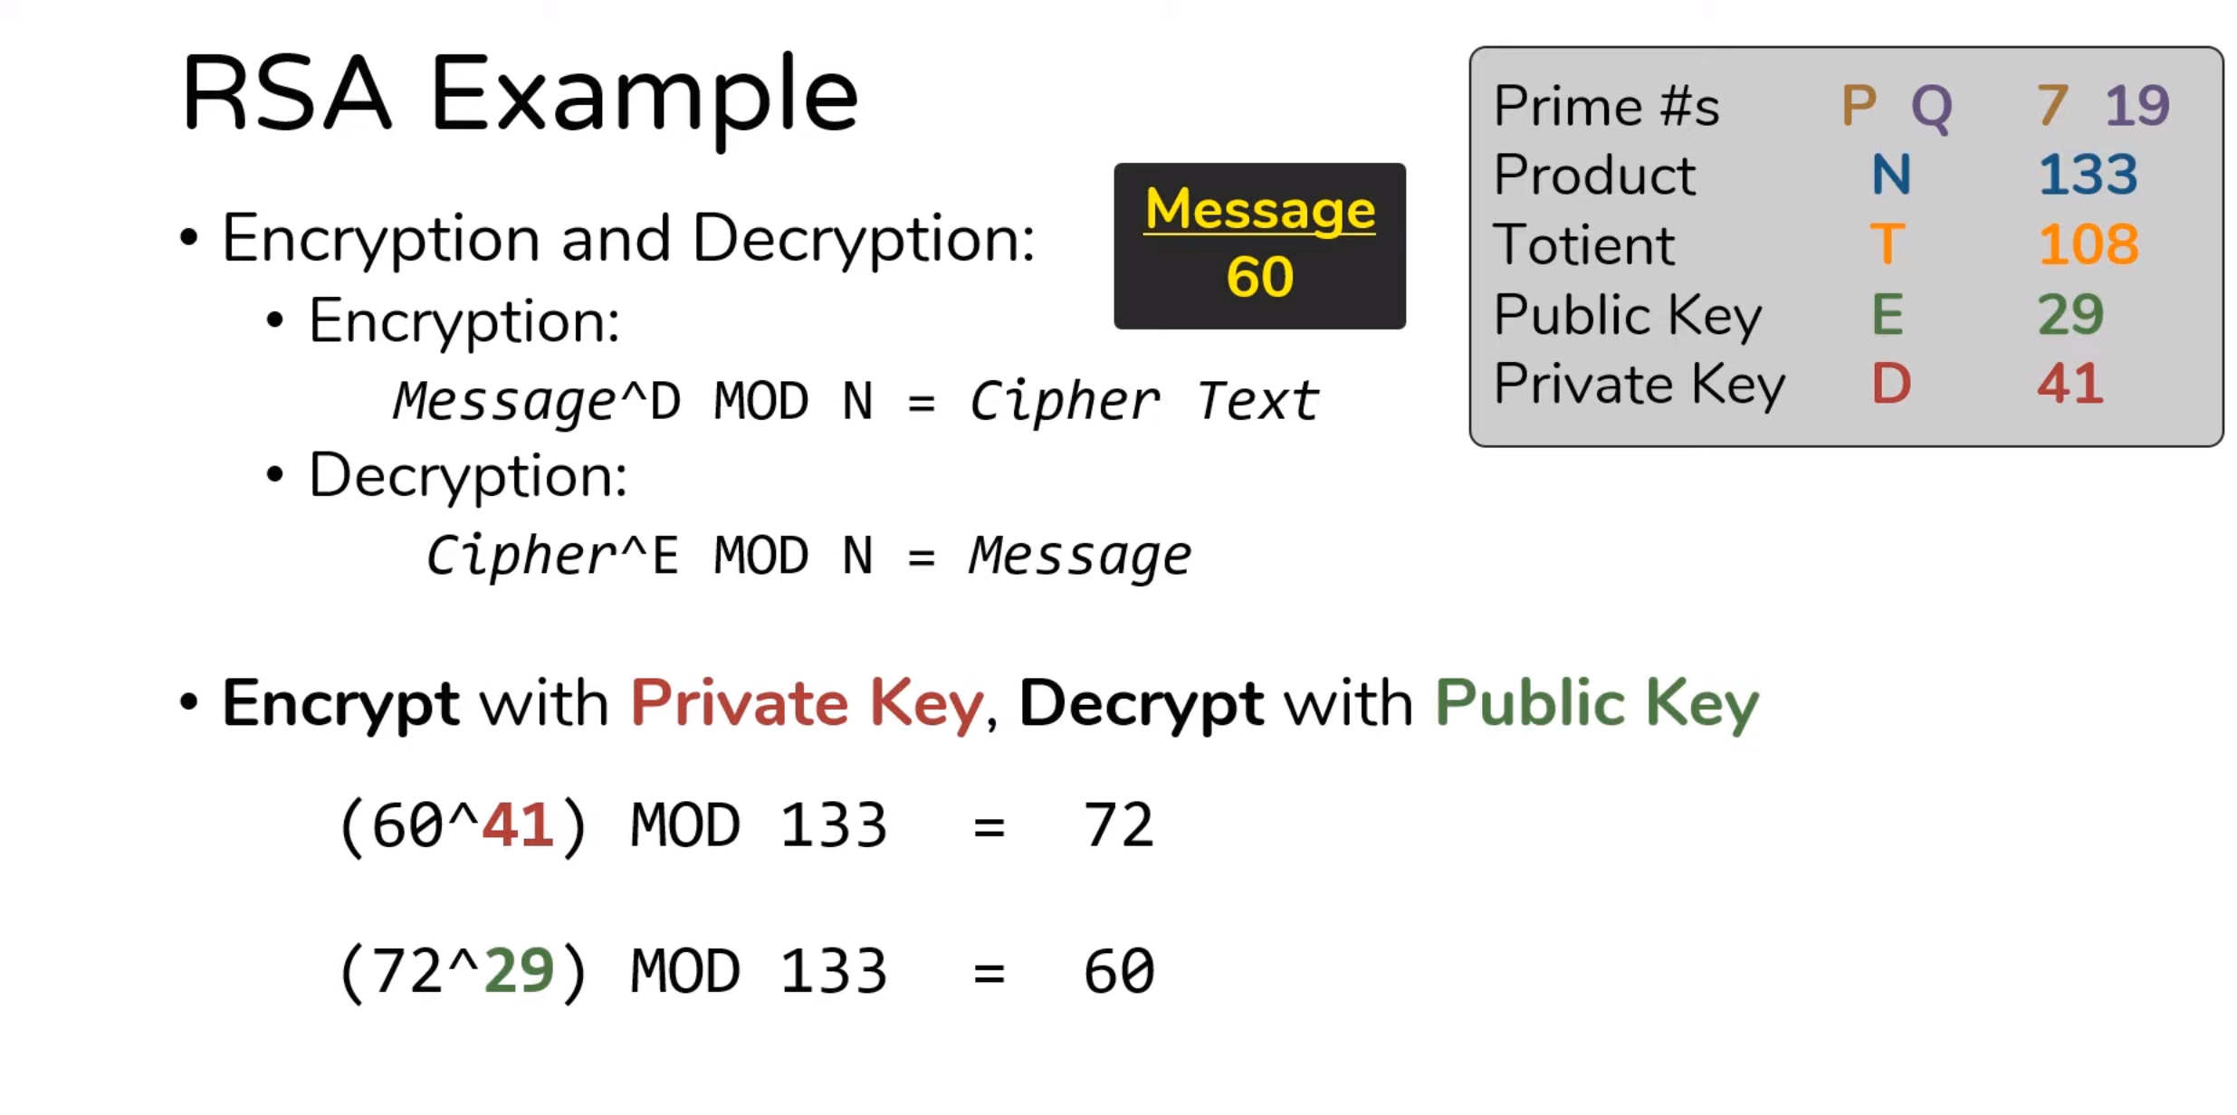

Slide 27
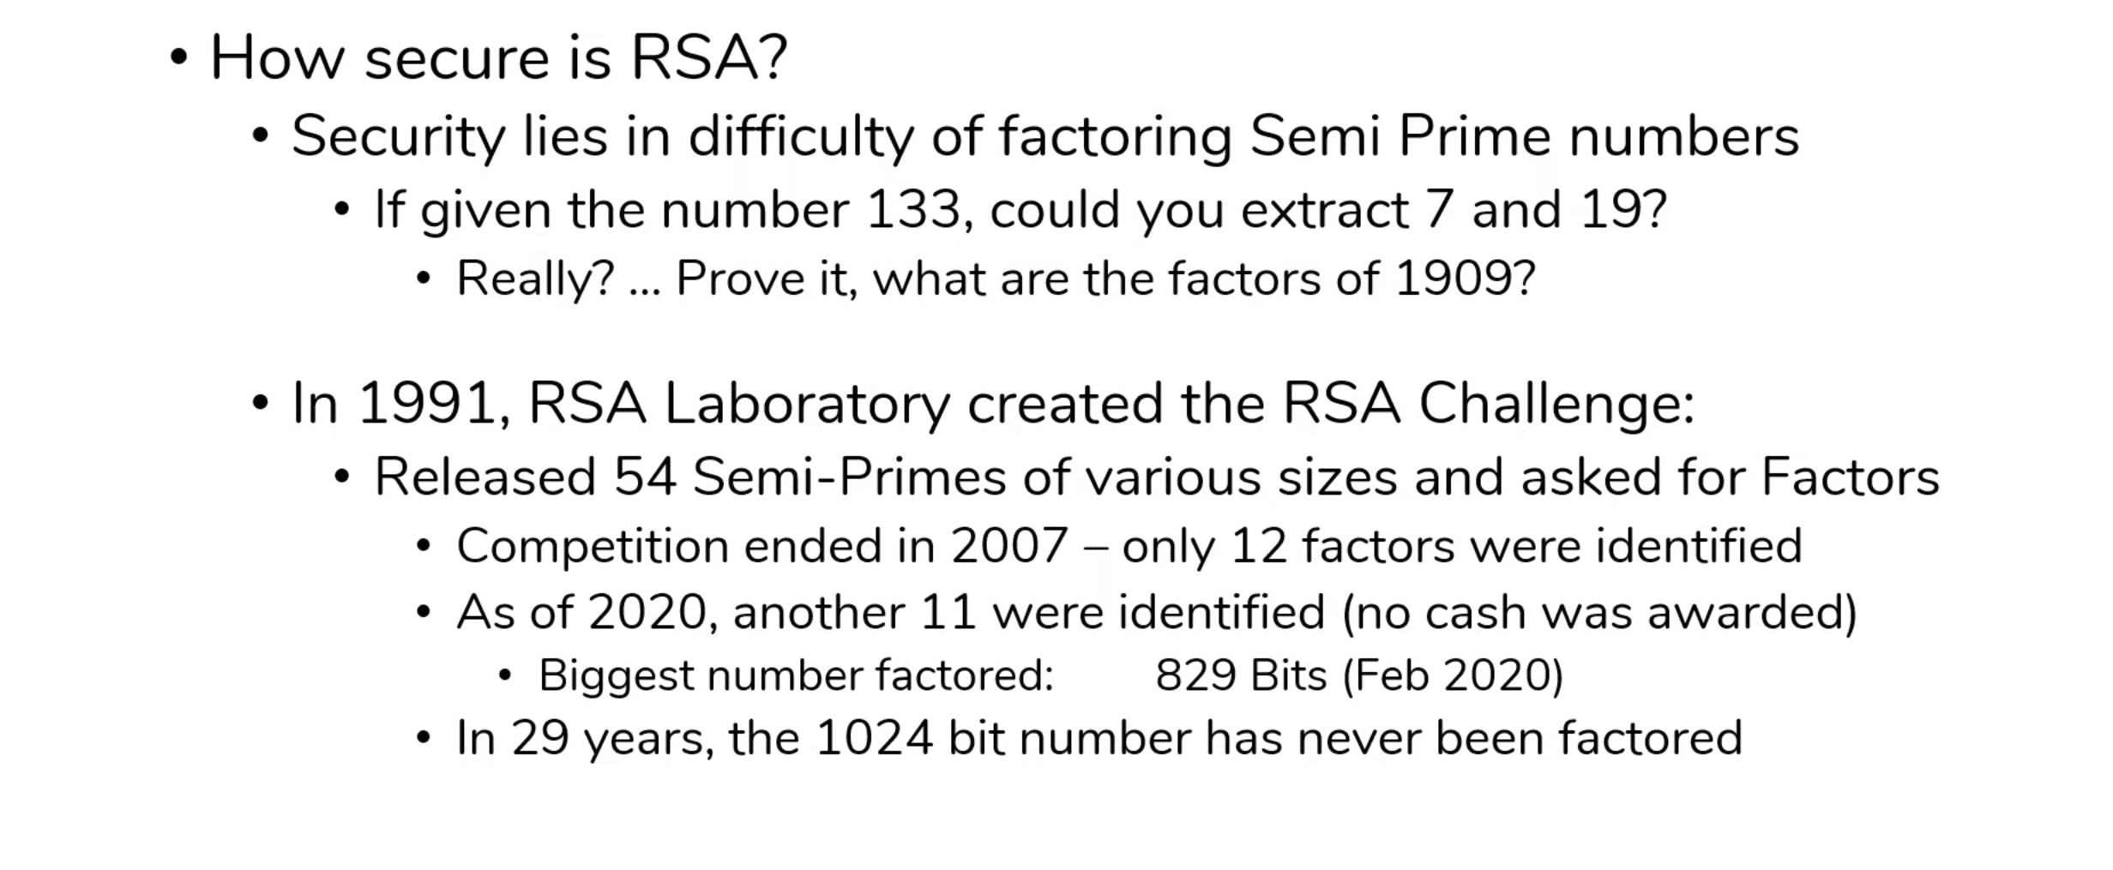
RSA Security

Slide 28
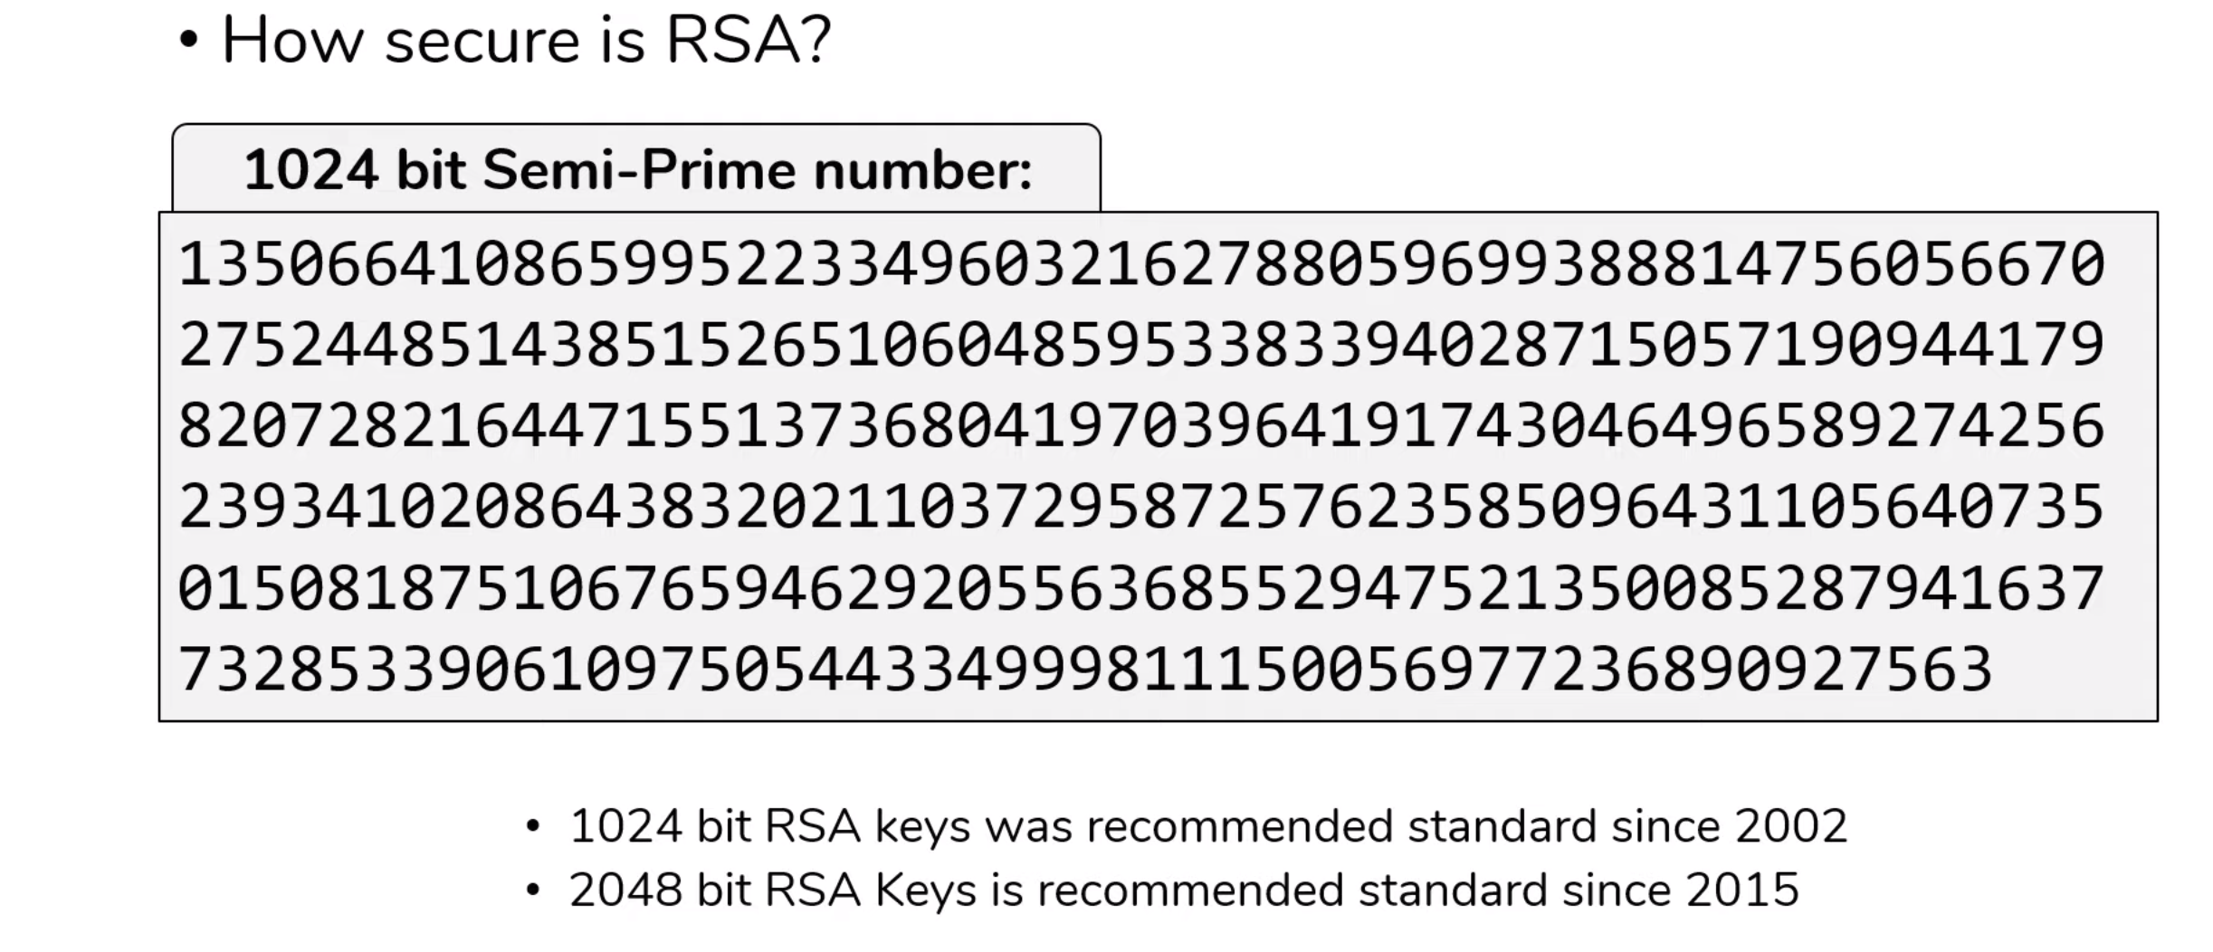

Slide 29
Hash Codes
In most files, the elements or components of the file are not bound together in any way.
That is, each byte or bit or character is independent of every other one in the file.
This lack of binding means that changing one value affects the integrity of the file but that one change can easily go undetected.
One technique for providing the seal is to compute a function, sometimes called a hash or checksum or message digest of the file.

Slide 30
Cryptographic Hash Functions
A hash function maps a message of an arbitrary length to a m-bit output (128 bits -512 bits)
h = H(M)
Output h known as the fingerprint or the message digest
If the message digest is transmitted securely, then changes to the message can be detected
The principal object of a hash function is data integrity.
usually assume hash function is public
A hash is a many-to-one function, so collisions can happen.
To check the integrity of a message M' at a later time, compute h' = H(M') and verify that h = h'.

Slide 31
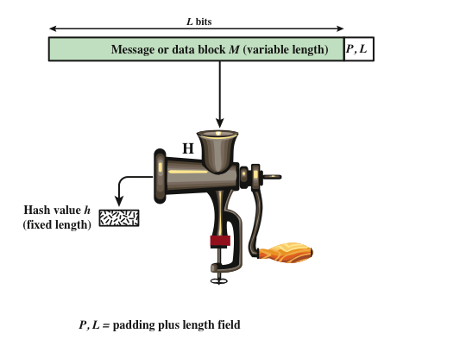

Slide 32
Hash function example
To see the change in the hash code produced by an innocuous (practically invisible) change in a message, h
Message: "A hungry brown fox jumped over a lazy dog"
SHA1 hash code: a8e7038cf5042232ce4a2f582640f2aa5caf12d2
Message: "A hungry brown fox jumped over a lazy dog"
SHA1 hash code: d617ba80a8bc883c1c3870af12a516c4a30f8fda
The diﬀerence between the two messages?

Slide 33
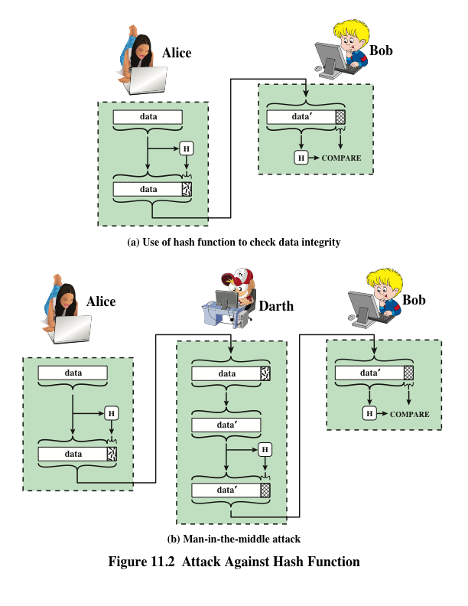

Slide 34
Preimage and Collisions
For hash value h = H(x), x is preimage of h
H is a many-to-one mapping; h has multiple preimages
Collision occurs if x ≠ y and H(x) = H(y)
Collisions are undesirable
Modern hash functions meet two criteria:
They are one-way, meaning they convert input to a digest, but it is infeasible to start with a digest value and infer the input
They do not have obvious collisions, meaning that it is infeasible to find a pair of inputs that produce the same digest

Slide 35
SHA
Secure Hash Algorithm, developed by NIST
Standardized by NIST in FIPS 180 in 1993
Improvements over time: SHA-0, SHA-1, SHA-2,SHA-3
SHA-1 (and SHA-0) are considered insecure; no longer recommended

Slide 36
Other Hash Function Uses
Uses of hash function
message authentication,
digital signatures,
one-way password file -store hash of password not actual password
intrusion/virus detection - keep & check hash of files on system
pseudorandom function (PRF) or pseudorandom number generator (PRNG)

Slide 37
Digital Signature
The hash value of a message is encrypted with a user’s private key
Anyone who knows the user’s public key can verify the integrity of the message
An attacker who wishes to alter the message would need to know the user’s private key

Slide 38
Session Summary – Part 1/2
Substitution, transposition, confusion, and diffusion are the basic primitives of cryptography
DES is a relatively simple symmetric algorithm that, although no longer practical, is useful for studying technique
Chaining and random initialization vectors are important techniques for preventing ciphertext repetition
AES remains the modern standard for symmetric encryption almost 20 years after its introduction

Slide 39
Session Summary – Part 2/2
RSA is a popular algorithm for asymmetric cryptography
Message digests use one-way cryptographic hash functions to detect message modification
Digital signatures use asymmetric encryption to detect forged messages

